Slide 1
Clash of Cos
Visual Pitch
Written by Luke Bell

Slide 2
Short Description
Top-Down Action game
Target Audience – 12+ gamers (silly, but skill level helps)
Optimize for
[I need to add images and a style/theme to slides]

Slide 3
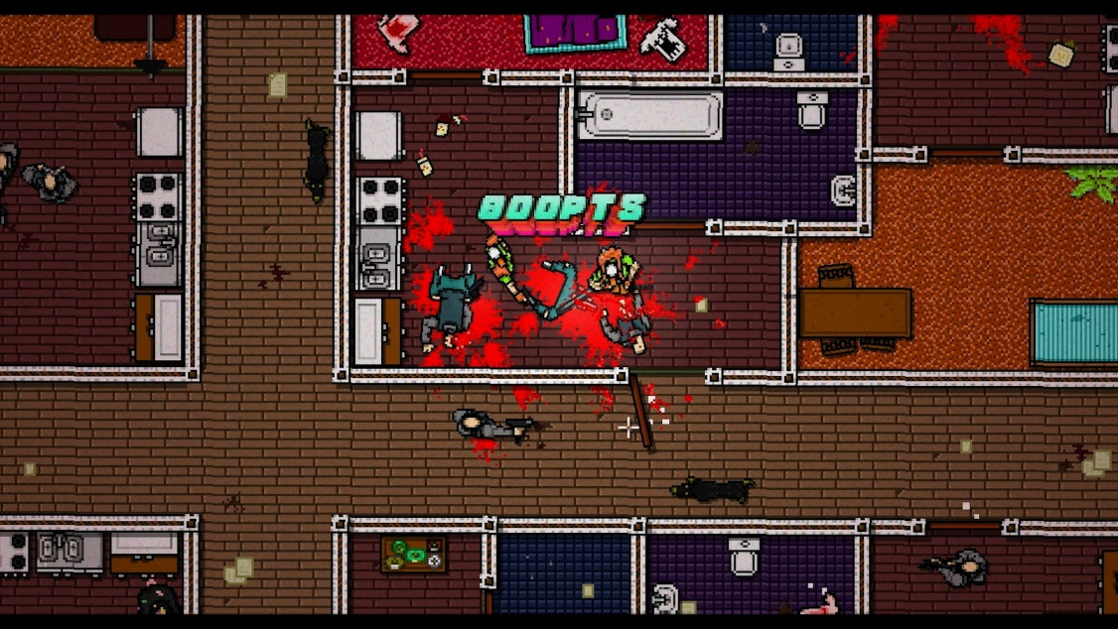
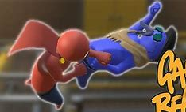
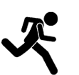

Overall Game Mood-board
Momentum – punch – knockback

Slide 4
Narrative Context
This is a show
Ran by enthusiasts with time to spare
they dress up as they please then enjoy beating each other up for entertainment

Slide 5
Player Character
A new contestant!

Slide 6
Mechanics and Gameplay

Slide 7
Gameplay Mood-board

Slide 8
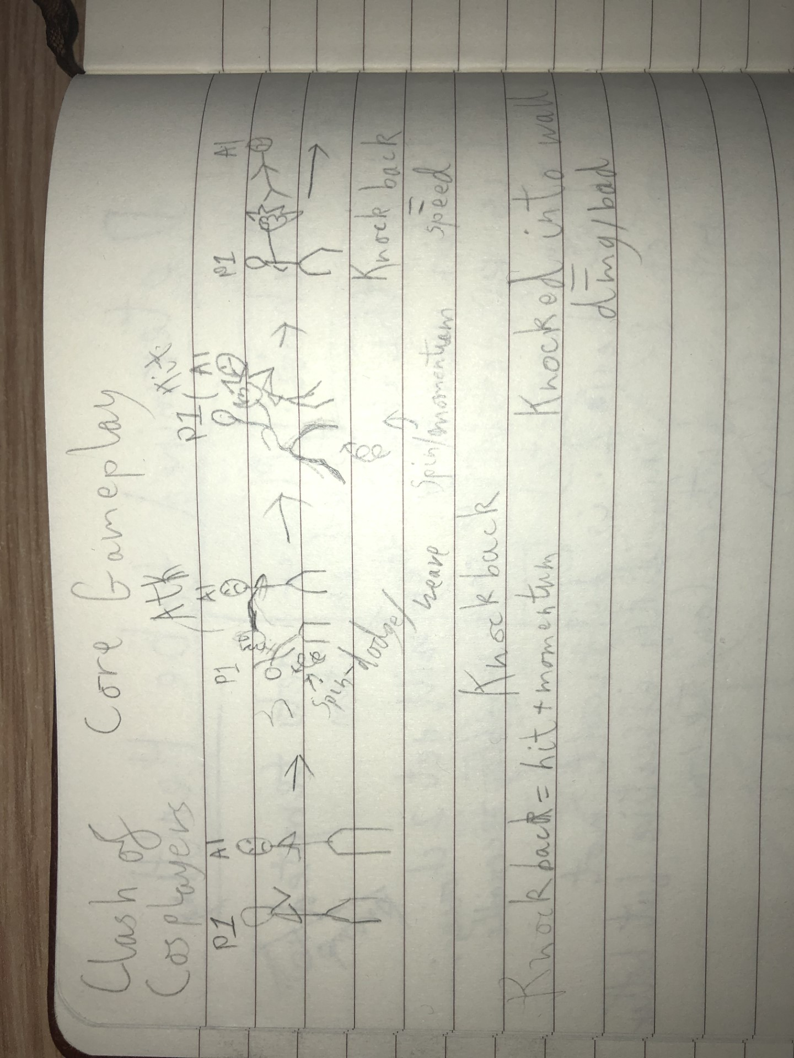
Core Gameplay
Weave/dodge swing/attack ragdoll/knockback/damage

Slide 9
Knock back

Slide 10
Interaction
[Controls layout]

Slide 11
Travel Gameplay/Mechanics

Slide 12
Equipment
We don’t need many buttons, so we could bind each equip key to corelating socket

Slide 13
Items

Slide 14
[Item-Category] Trolley

Slide 15
Threats

Slide 16
Basic Thug
We can add enemy variety with different weapons/equipment
Bosses could also add variety (if we perscribe sufficient time)
No weapons (so little damage)
Only option is to attack player with melee
{maybe we allow friendly fire – helps with the repetitive nature of melee enemies ganging up on the player, and also entertaining}
[each enemy weapon type we use will have it's own slide to allow for more detail]

Slide 17
Zeus – AI Boss Enemy
Takes more hits to beat
Can use lighting to damage and stun/ragdoll player
Defeat gives Taser

Slide 18
World Mechanics

Slide 19
Wall Bounce
Knock back into wall deals little extra damage [additional cool thing to make combat more varied]

Slide 20
Conveyer Belt
[Very gangbeasts – also additional]

Slide 21
Terrain that is item
Tables and furniture and stuff that player can use as a wall or cover, but also pick up for shenanigins (violence) [also additional]

Slide 22
Non-Player Characters

Slide 23
Announcer
Basicaly Narator
They explain things
Game is basicaly a game show that they announce [either text or voiced dialogue would work fine]
They are a hype man, they're dramatic, and snarky

Slide 24
"Zeus"
[explanation of double Zeus entry]While they are a threat, they're presence as an NPC would be separate from Zeus the threat if we did not make the connection clear (through label and narative context)
Will talk shit
Talk about the good fight (even if they lost – like they're trying to save face)
Will break character eventually
Egotist nerd

Slide 25
Game to Player Feedback
Ways the game will convey information to the player
Combat
Ragdolls need to be Obvious
Ideally sound effect indicate impact/damage
Progress
An enemy count could work
Anoucer comments
Boss Talks

Slide 26
Level Designs

Slide 27
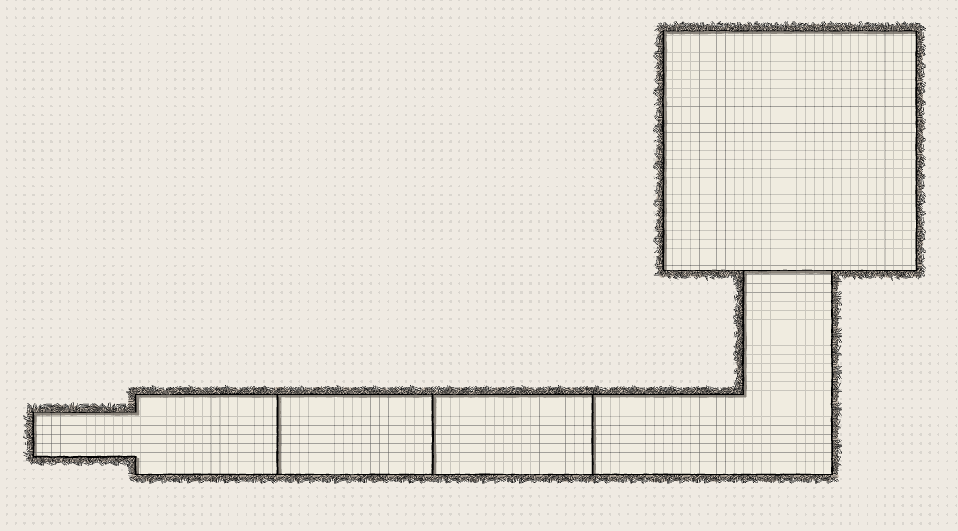
Tutorial Design Sketch

Slide 28
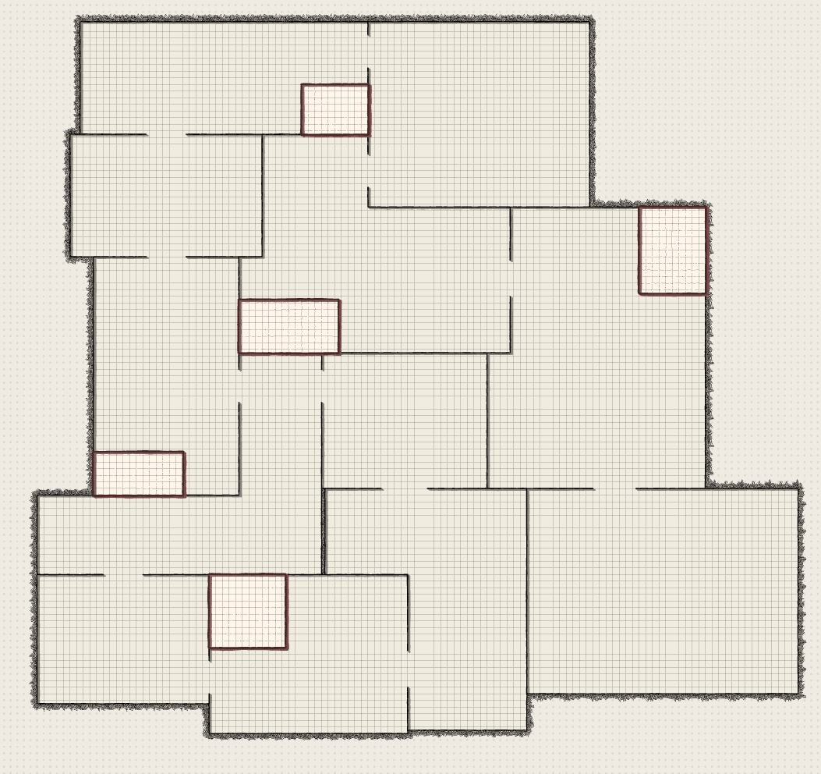
1st Level Design Sketch

